Slide 1
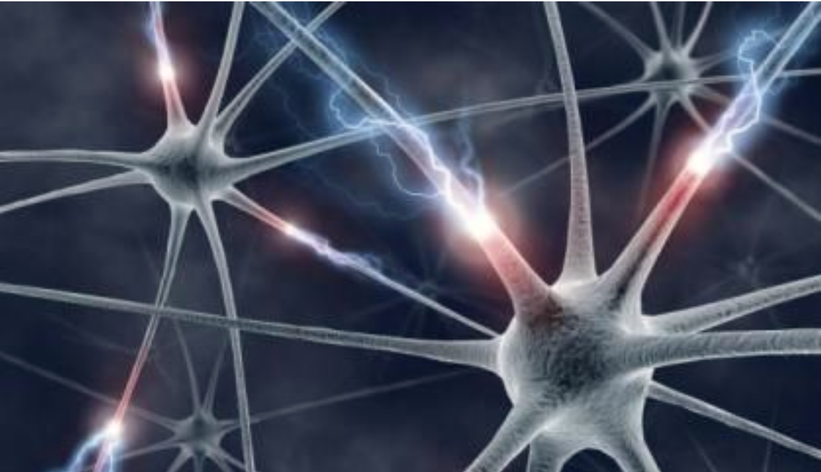



CaPC Learning: Confidential & Private Collaborative Learning
Adam Dziedzic
Postdoctoral Fellow
ady@vectorinstitute.ai
Notes:
Hello everyone, thank you Patricia for the introduction. My name is Adam Dziedzic and I have a pleasure to present to you CaPC Learning, which is Confidential & Private Collaborative Learning. This is supposed to be an interactive talk, so please ask questions during the talk.
I’m sorry for not showing up in the morning. I (pri-rycordyd) pre-recorded my talk and but it seems that it’s better to give it live.

Slide 2

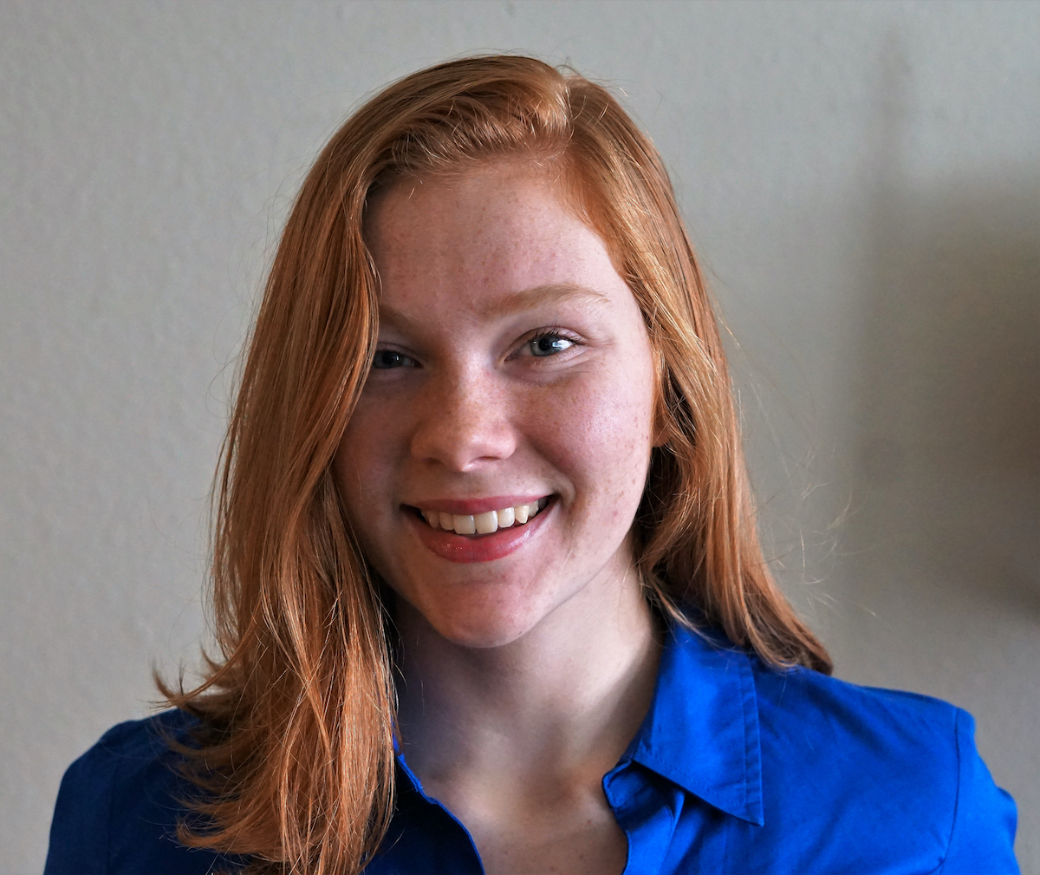
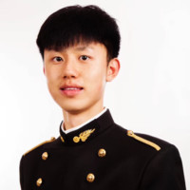
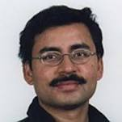

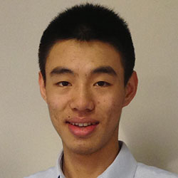
Collaborators
Christopher A.
Choquette-Choo
Natalie Dullerud
Yunxiang Zhang
Somesh Jha
Nicolas Papernot
Xiao Wang
Notes:
This is joint work with my collaborators: Chris, Natalie, Yunxiang, Somesh, Nicolas, and Xiao.

Slide 3


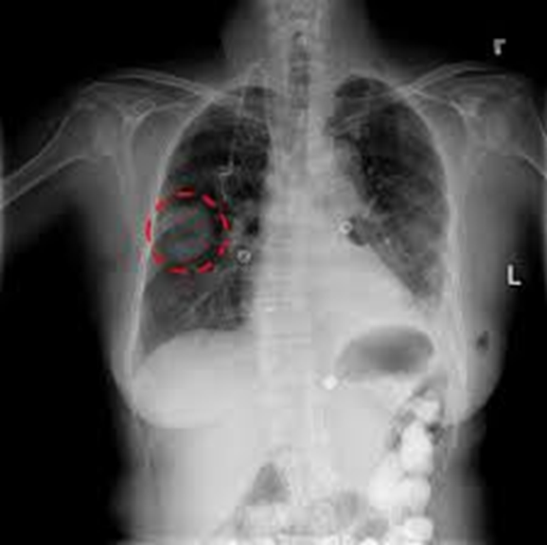
Private Consultation
Aggregation
Disease
3
Notes:
Let us imagine that there is a patient who comes to a hospital in Nothern (no’dern) Ontario in Canada. The doctor has not had such a case before. So the doctor is not confident about his or her diagnosis and wishes to consult with hospitals in Toronto (to’ronto), in Southern (sa’dern) Ontario. The doctor sends the chest X-ray of the new patient to hospitals in Toronto (to’ronto). These hospitals label the x-ray and aggregate the results to aggree on a single most probable disease. Intuitively, what we achieve is an analog of a doctor querying colleagues for a second opinion on a difficult diagnostic.

Slide 4

How to Protect Confidentiality and Privacy?
2
Aggregation
Disease
1
4
Notes:
However, there are two issues here. First, the hospitals in Toronto (to’ronto) do not want the liability for managing the private data and patient would have to allow us to send his or her data to all of these hospitals, which is a lot of paper work.

Slide 5
1. Requirements & Overview 2. CaPC Protocol 3. Empirical Evaluation
Notes:
My talk is divided (dy’wajdyd) into 3 main sections. First, I’ll state the requirements for CaPC and present a high-level overview of the protocol. Then, I’ll walk you through the CaPC protocol step by step. Finally, we will go through many experimental results to asses the protocol.

Slide 6
Requirements for CaPC
Requirement | What do we do?
Privacy of training data | Guarantee protection of personally identifiable information contained in training data via Differential Privacy.
Query confidentiality | Encrypt input data and do inference on encrypted data using Homomorphic Encryption and Secure Multi-Party Computation.
Model confidentiality | Prevent leakage of the answering parties’ models to the querying party.
Notes:
So, more systematically, what we want to achieve is: First, the privacy of training data. We do it via adding Gaussian random noise adaptively and achieve the (dyfe’rential) differential privacy. Model outputs (which are computed on private data) can indirectly leak information about a party’s training set. In particular, sharing model parameters, gradients, or outputs in form of logits or predictions, enables a curious querying party to infer sensitive information about the individual data records from the training set. Major inference attacks include membership inference attacks (which can determine if a given data point is part of the training set of a model) and attribute inference attacks (which infers features of the training data, or statistical information about them).

Slide 7

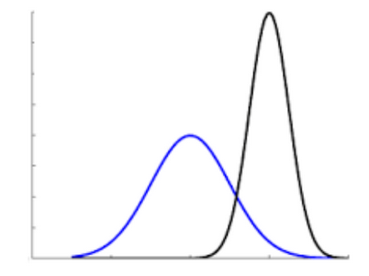
Use CaPC in Healthcare
Hospitals act as collaborating parties.
Protect privacy & confidentiality of patients’ data.
Using collaborative learning setup to investigate and possibly address some of the issues in healthcare.
Strong Privacy Guarantees
Private Consultation
Robustness to Distribution Shift
Notes:
One of the primary applications for CaPC is in the healthcare setting with hospitals acting as collaborating parties. The hospitals are obliged (e’blajdzd) to protect privacy and confidentiality of the patient’s data. CaPC provides strong privacy guarantees. It is a protocol for private consultation, and also it addresses some issues in robustness to data distribution shift.

Slide 8


Privacy of Train & Confidentiality of Test Data
Differential Privacy
Answering Parties
Labels
Healthy
Cancer
Querying
Party
Encryption
Unlabeled
Data
8
Notes:
To tackle the problems of privacy and confidentiality, we use the (dyfe’renszial) differential privacy and encryption. First, we encrypt the unlabeled data and do inference on encrypted data, which provides confidentiality. Next, we use the PATE framework to provide (dyfe’renszial) differential privacy. We aggregate the labels from the models on the left-hand side that belong to answering parties, we add Gaussian noise, and such processed labels are finaly released to the querying party.

Slide 9
CaPC Workflow
Private Inference
Blind Outputs
Compute Labels
Add DP Noise + Aggregate Labels
Unblind Final Label
1a
1b
1c
2
3
9
Notes:
What are the main processing blocks in CaPC? We start from the private inference on encrypted data. Then we blind the outputs, compute labels, add DP noise, and aggregate the labels. The last step is to unblind the final answer.

Slide 10
Actors in CaPC
Querying Party
Send encrypted query
1a
Compute
Labels
1b
1c
Unblind
Labels
Blind
Outputs
3
Label
Differential Privacy
2
Enc(q)
Answering Parties
Logits
Enc(r_{n})
P_{n}
Enc(r_{n}- r̂_{n})
Privacy Guardian
Generate random vector r̂_{n}
10
Notes:
The CaPC protocol has 3 main actors. The querying party which sends a data item to be labeled, the answering parties that run the private inference, and the 3rd trusted party called Privacy Guardian. We add the third trusted party to be able to privately aggreagate the labels and add the DP noise.

Slide 11
1. Requirements & Overview 2. CaPC Protocol 3. Empirical Evaluation
Notes:
Now, we’ll move on to the details of the CaPC protocol.

Slide 12
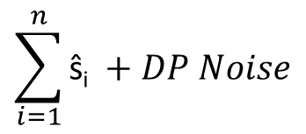
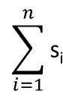
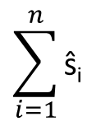
CaPC Protocol
Querying Party
(r₁- r̂₁)
s₁
$$\sum_{i=1}^{n}{\text{s}\text{i} }$$
Decrypt
. . .
. . .
P_{Q}
(r_{n}- r̂_{n})
s_{n}
P_{Q}
One-hot
encoding
Send encrypted query Enc(q)
1a
Send
Enc(r_{n} - r̂_{n})
1b
1c
ŝ_{1 …} ŝ_{n}
3
Noisy
argmax
Label
Answering Parties P₁ … P_{n}
Enc(q)
Logits
Enc(r_{n})
2
P_{n}
Enc(r_{n}- r̂_{n})
Privacy Guardian
$$\sum_{i=1}^{n}{\text{ŝ}\text{i} }$$
Gaussian noise
$$\sum_{i=1}^{n}{\text{ŝ}\text{i} }+DP Noise$$
Generate random vector r̂_{n}
12
Notes:
To make the discussed concepts more concrete, I will walk you through the CaPC protocol step-by-step. So, this diagram presents the flow of data in CaPC.

Slide 13
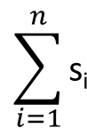
Noisy Argmax
Querying Party
(r₁- r̂₁)
$$\sum_{i=1}^{n}{\text{s}\text{i} }$$
Decrypt
. . .
P_{Q}
(r_{n}- r̂_{n})
P_{Q}
Send encrypted query Enc(q)
1a
Send
Enc(r_{n} - r̂_{n})
Healthy
Cancer
1b
3
Noisy
argmax
Label
Answering Parties P₁ … P_{n}
Enc(q)
Logits
Enc(r_{n})
P_{n}
Enc(r_{n}- r̂_{n})
Privacy Guardian
$$\sum_{i=1}^{n}{\text{ŝ}\text{i} }$$
Gaussian noise
$$\sum_{i=1}^{n}{\text{ŝ}\text{i} }+DP Noise$$
Generate random vector r̂_{n}
13
Notes:
The result is a noisy histogram of number of votes for each class. We obtained this histogram by adding the noisy one hot vectors. For illustration, here we have two classes and have to decide if a patient is Healhty or has a Cancer. We take the argmax and the class with max votes, in this case Healthy, is returned to the querying party as the predicted label.

Slide 14
Confidentiality & Privacy Guarantees
Honest-but-curious setting – adversary follows the protocol but tries to infer information from the protocol transcript.
Semi-trusted third party - PG (Privacy Guardian) does not collude with any other party.
If PG colludes with a querying party (and no noise added) – there is no privacy protection.
Perfect confidentiality – assumed above, protocol reveals nothing except the final noised result to the querying party.
Strong privacy – when at most 1 corrupted answering party.
Privacy degrades only and proportionally to the number of corrupted answering parties.
Privacy leakage only to the querying party when more than a single answering party is corrupted.
Notes:
One or more corrupted parties have no impact on confidentiality. The privacy guarantee degrades proportionally to the number of corrupted answering parties. The potential privacy leakage is to the querying party. The worst scenario in terms of privacy is when the Privacy Guaradian colludes with the querying party. Then there is no privacy protection.

Slide 15
1. Requirements & Overview 2. CaPC Protocol 3. Empirical Evaluation
Notes:
Hopefully, the details of the CaPC protocol are clear now, and we can move on to the empirical evaluation.

Slide 16
Homogenous Architecture
SVHN on VGG-7, 250 parties, $ε=2.0$, $δ={10}^{−6}$, uniform distribution
2%
16
Notes:
We also present the average accuracy across all classes. The blue dashed line is accuracy before CaPC and the red dashed line is accuracy after running the CaPC protocol. Overall, the increase in accuracy of the querying party is by about 2%.

Slide 17
Heterogenous Architecture
SVHN on VGG-7, ResNet-8, ResNet-10, 250 parties, $ε=2.0$, $δ={10}^{−6}$, uniform distribution
2.6%
17
Notes:
The overall accuracy gain after running CaPC is of about 2.6%. Thus, CaPC enables the collaboration between parties that have models with different types of architecture and helps to improve the accuracy of the models.

Slide 18
Active Learning
18
Notes:
Before we move on to the next experiment, we’ll have a short segue (seguej) into active learning.

Slide 19
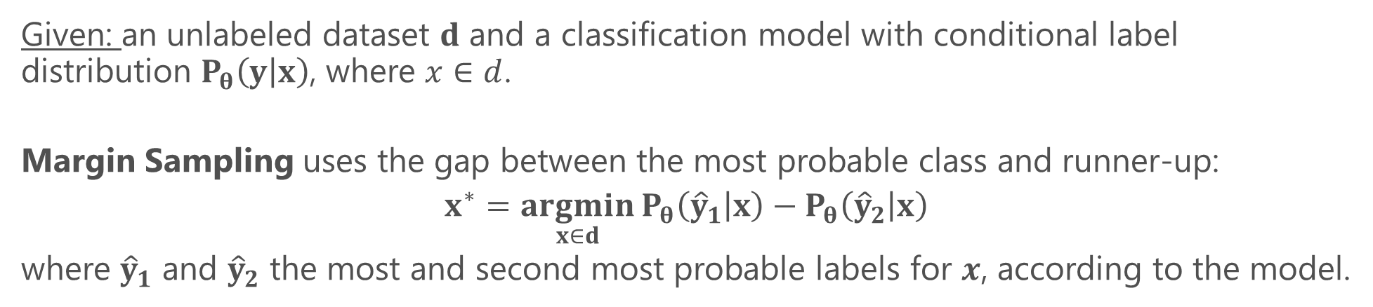
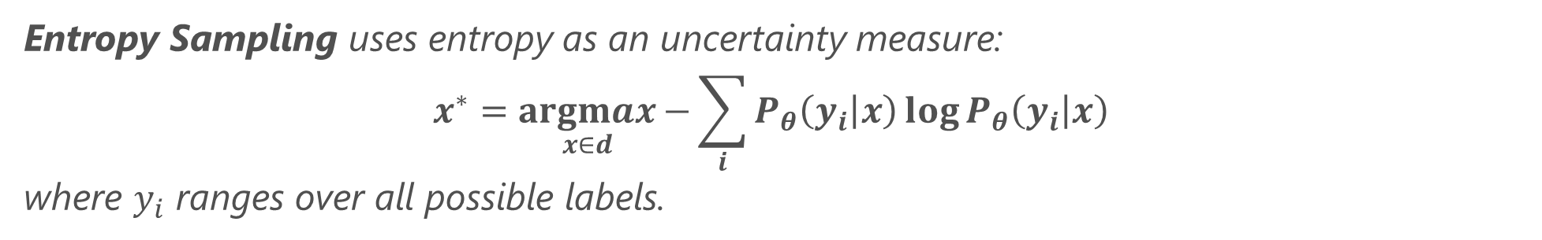
Active Learning for Query Selection
Given: an unlabeled dataset $d$ and a classification model with conditional label distribution $P_{θ}\left(y | x\right)$, where $x∈d$.
Margin Sampling uses the gap between the most probable class and runner-up:
$$x^{∗}=\underset{x∈d}{argmin}{P_{θ}\left({\hat{y}}_{1} | x\right)}−P_{θ}\left({\hat{y}}_{2} | x\right)$$
where ${\hat{y}}_{1}$ and ${\hat{y}}_{2}$ the most and second most probable labels for $x$, according to the model.
Entropy Sampling uses entropy as an uncertainty measure:
$$x^{∗}=\underset{x∈d}{argmax}{−\sum_{i}{P_{θ}\left(y_{i} | x\right)}\log{P_{θ}\left(y_{i} | x\right)}}$$
where $y_{i}$ ranges over all possible labels.
19
Notes:
We also employ the entropy sampling. Intuitively, we select the sample whose probability distribution is closer to the uniform distribution. On the other hand, if the distribution of probabilities of classes for a given sample is close to a deterministic one, probability of a single class is dominant, then its entropy is almost zero – which means that we know which is the most probable label for the sample, and usually we do not need to label such a sample.

Slide 20
Non-uniform Data Distribution
SVHN on VGG-7, 250 parties, $ε=2.0$, $δ={10}^{−6}$, classes 1 & 2 are under-represented
5.7%
20
Notes:
We observe that CaPC with different sampling methods increases the balanced accuracy of the querying model by about 5.7%.

Slide 21
Non-uniform Data Distribution
SVHN on VGG-7, 250 parties, $ε=2.0$, $δ={10}^{−6}$, classes 1 & 2 are under-represented
21
Notes:
When we zoom in the two under-represented classes 1 and 2, we see that the entropy and margin sampling methods increased the balanced accuracy of these classes more than the random selection of samples. This is because the less-represented classes have a higher margin and entropy, and samples from these less represented classes are selected more frequently. In general, CaPC can significantly improve the fair performance of models as measured by balanced accuracy, especially when combined with active learning.

Slide 22
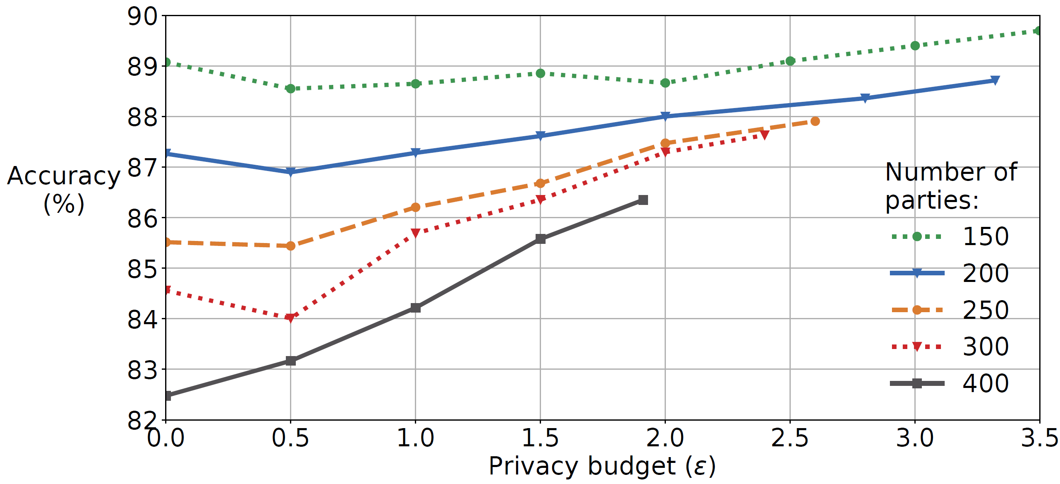
Accuracy Gain vs Number of Parties
SVHN on VGG-7, 250 parties, $ε=2.0$, $δ={10}^{−6}$, uniform distribution
3.87%
22
Notes:
On the other hand, with many more parties, for example, with 400 parties, the accuracy of the individual models is low, about 82.5% because the models are trained on smaller data subsets. The accuracy gain is substantial, about 3.87% and also it is obtained for a lower privacy budget of about 1.9. In general, we observe that the more parties collaborate in CaPC, the tighter the bound on privacy budget epsilon and higher gains in accuracy.

Slide 23
Computational Cost of Private Inference
1a
23
Notes:
In this experiment we measure the utilization of resources (CPU, Network transfer (denoted as NET), and memory usage (denoted as MEM)) during execution of the private inference, which is step 1a in the CaPC protocol. The network usage reaches its peaks during execution of ReLU, then two AveragePooling operations and then a single ReLU layer, where the intermediate feature maps have to be exchanged between the querying and answering parties for the Secure Multi-Party Computation. The peaks in the CPU utilization are due to the computation of 2 convolutional layers and 2 fully connected layers. This micro-benchmark was done for a small version of LeNET and MNIST dataset, so the memory overhead is negligible.

Slide 24
Small Computational Overhead of CaPC
Private
Inference
(only)
1a
CaPC
24
Notes:
CaPC does not add much overhead on top of the Private Inference. Private Inference is the main performance bottleneck in the protocol. CaPC only exchanges a few vectors so not much more network transfer is required and the computational cost is also relatively low.

Slide 25
CaPC | Federated Learning
Cross-silo setting, e.g., organizations | Cross-device setting, e.g., phones
Improve local models in each party by labeling new data points | Train central model without explicitly combining the parties’ datasets
For heterogenous models and also non-differentiable models (trees) | Only for homogenous and differentiable models
Returns only predicted labels | Transfers gradients or parameters (large data transfer required)
Fewer parties required for privacy | Many more parties required
Provides confidentiality of data to be labeled & privacy (no gradients revealed) via Pâté. | Provides condifentiality but much higher cost of privacy (gradients shared allow us to infer private data)
Notes:
Before we conclude, I wanted to compare CaPC with Federated (fede’rejtyd) Learning from different perspectives, such as the setting where the frameworks can be used, model architecture, and privacy.

Slide 26
Conclusions
CaPC protocol for privacy preserving collaboration and learning.
Privacy of train data with differential privacy & Pâté.
Confidentiality of test data via secure multi-party computation and homomorphic encryption.
Participants label their new data items and use them to improve their own ML models.
CaPC improves performance of models with heterogenous architectures and when there is skew in data.
Notes:
In conclusion. CaPC protocol provides confidential and private collaborative learning. The privacy of the training data from the answering parties is preserved using differential privacy via the PATE framework. On the other hand, the confidentiality of the test data from querying parties is provided using secure multi-party computation and homomorphic encryption. We use active learning methods for query selection and show improvement of models from the querying parties when we deal with heterogeneous architectures or a skew in datasets.

Slide 27
Thank you
27
Notes:
With that, I’d like to thank you for your attention and I’d be happy to answer any more questions.

Slide 28
Backup
28
Notes:
Backup

Slide 29
Definitions
Privacy - aims to guarantee proper protection of personally identifiable information, against inference attacks.
Confidentiality - aims to guarantee non-disclosure of sensitive information to unauthorized entities.
Integrity - aims to prevent unauthorized modification of data and models.
Secure Multi-Party Computation – a way for parties to compute a function jointly while keeping their inputs secret. In ML, this function can be a model’s loss function during training, or the model itself in inference.
Notes:
Secure MPC - For example, in the medical field, a cloud service provider could run a trained classification model on secretly shared patient data and send the secretly shared result (e.g., a prediction of a disease) back to the patient. However, this can leak private information about the training set on which the model was trained.
The goal of a secure two party computation for parties x, y is to compute a common function F that takes inputs from x and y by exchanging messages only with each other without revealing their inputs and without having to rely on a third trusted party. The parties should learn no more by engaging in their protocol than they would learn by interacting with an incorruptible, perfectly trustworthy third party. In particular, all that the parties can learn is what they can learn from the output and their own input.
splitting the data into shares is the encryption, adding the shares back together is the decryption,

Slide 30
Definitions
Secret Sharing - splitting the data into shares is the encryption, adding the shares back together is the decryption.
Notes:
Secure MPC - for example, in the medical field, a cloud service provider could run a trained classification model on secretly shared patient data and send the secretly shared result (e.g., a prediction of a disease) back to the patient. However, this can leak private information about the training set on which the model was trained.
Secret sharing - splitting the data into shares is the encryption, adding the shares back together is the decryption.

Slide 31
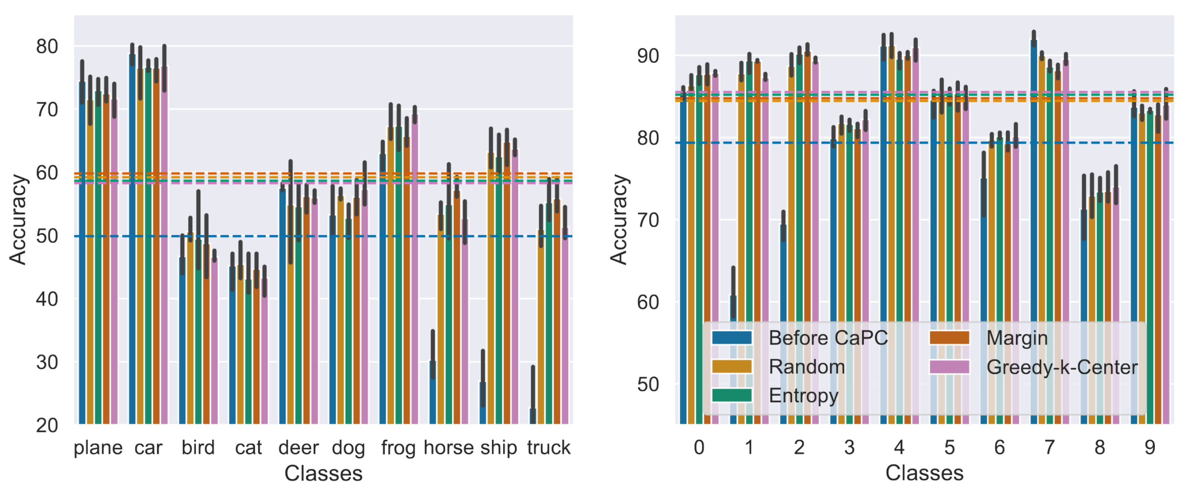
Balanced accuracy under non-uniform data distribution via Active Learning
Notes:
We use CaPC with active learning to improve balanced accuracy under non-uniform data distribution. The blue dashed line is accuracy before CaPC. We observe that all sampling strategies significantly improve balanced accuracy. The best active learning scheme can improve balanced accuracy by a total of 9.94 percentage-points (an additional 0.8 percentage points over Random sampling) on CIFAR10 (left) using Margin method and a total of 5.67 percentage-points (an additional 0.38) on SVHN (right) using the Greedy-k-Center.

Slide 32
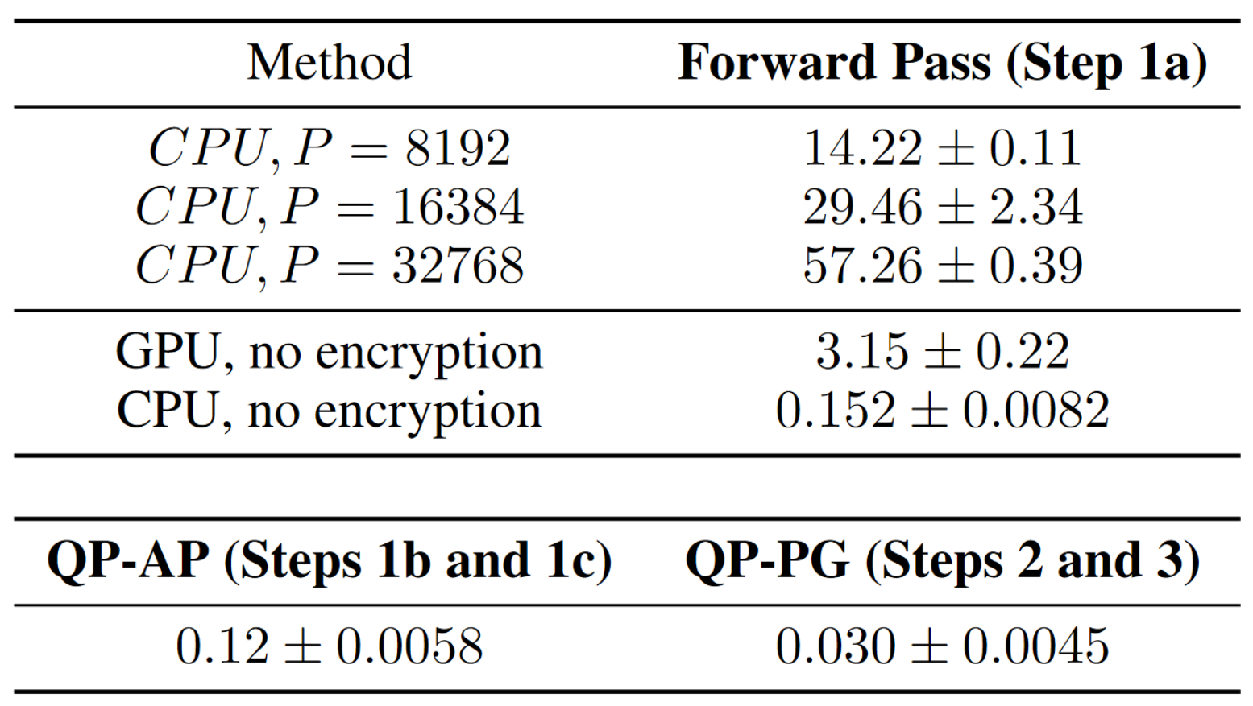
Break-down of the execution time
Notes:
Wall-clock time (sec) of various encryption methods with a batch size of 1.We vary the modulus range, P for homomorphic encryption, which denotes the max value of a given plain text number. Note that the GPU is slower than the CPU because of the mini-batch with a single data point and data transfer overhead to and from the GPU. We use the CryptoNet-ReLU model provided by HE-transformer.

